Slide 1
TechCrunch
A Simple Topic Recommender

Slide 2


Slide 3
Build a simple recommender that suggests similar topics given a user’s preferred topic

Slide 4
Data Collection

Slide 5

40,000 Posts

Slide 6
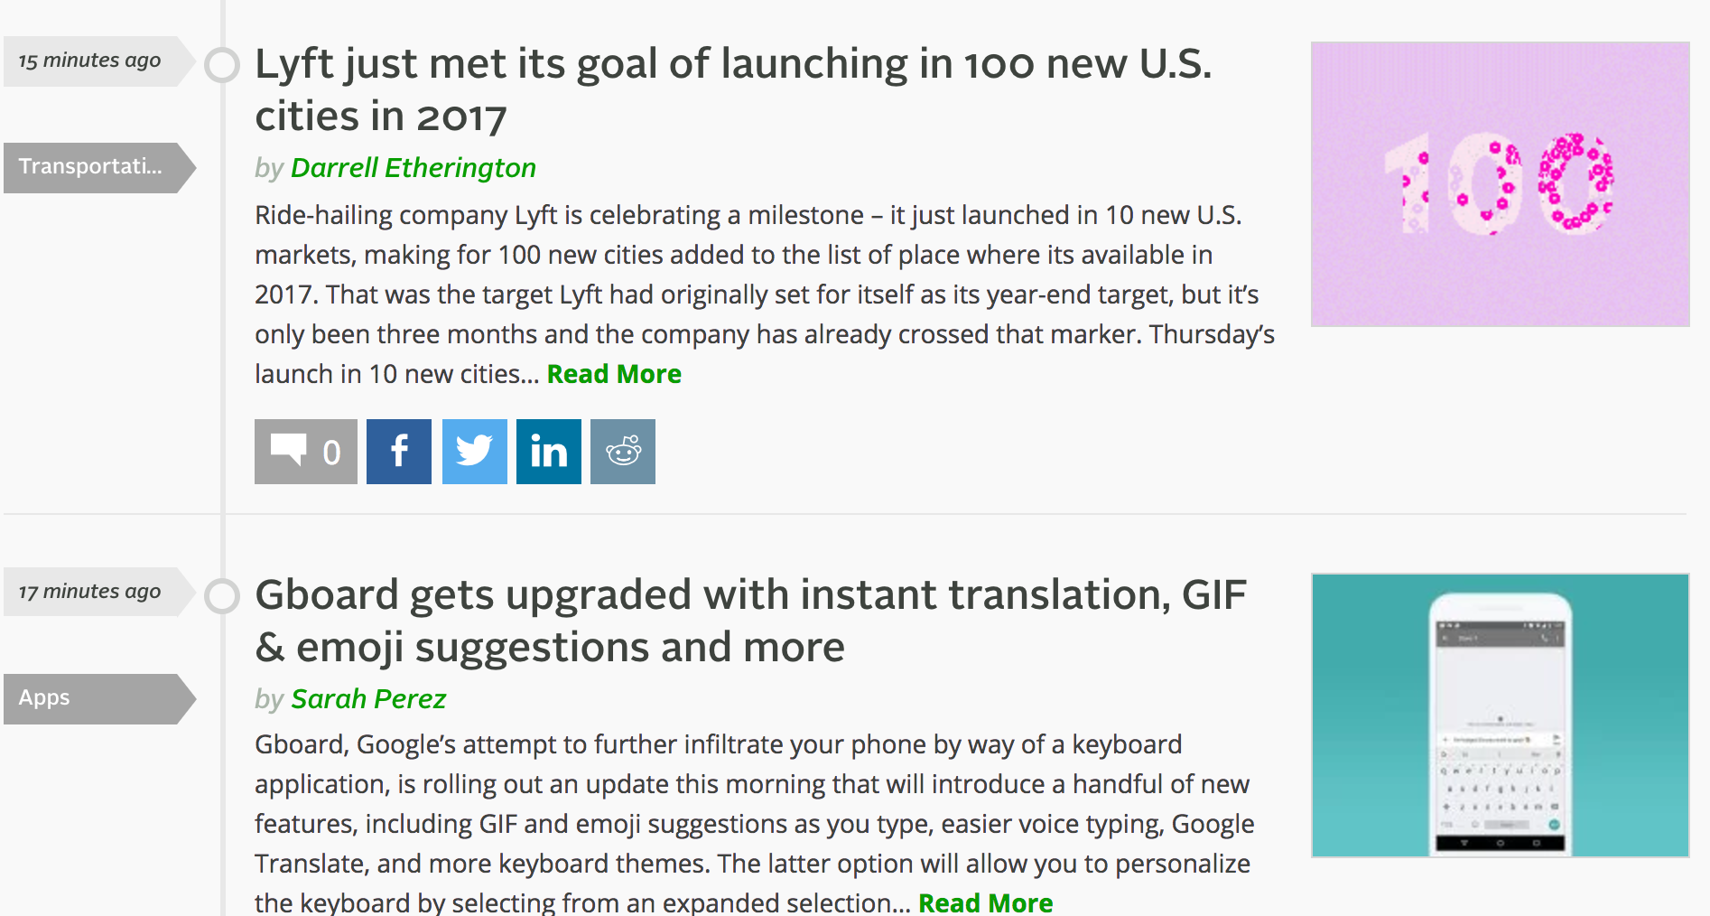

Slide 7
Author
Category
Section
Tag
URL

Slide 8
Natural Language Processing

Slide 9
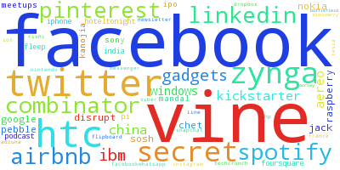

Slide 10


Slide 11


Slide 12
Users
User

Slide 13
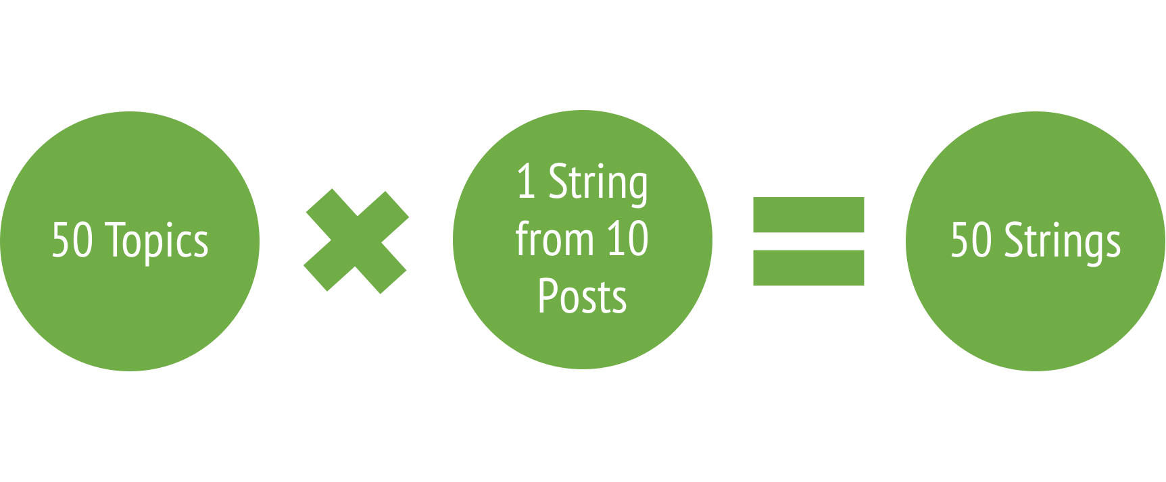

Slide 14
'twitter announc remov music app app store later afternoon alreadi download app stop work april music disappear surpris high profil launch earli last year app popular wane fall regard failur … ...’

Slide 15
Recommendation System

Slide 16
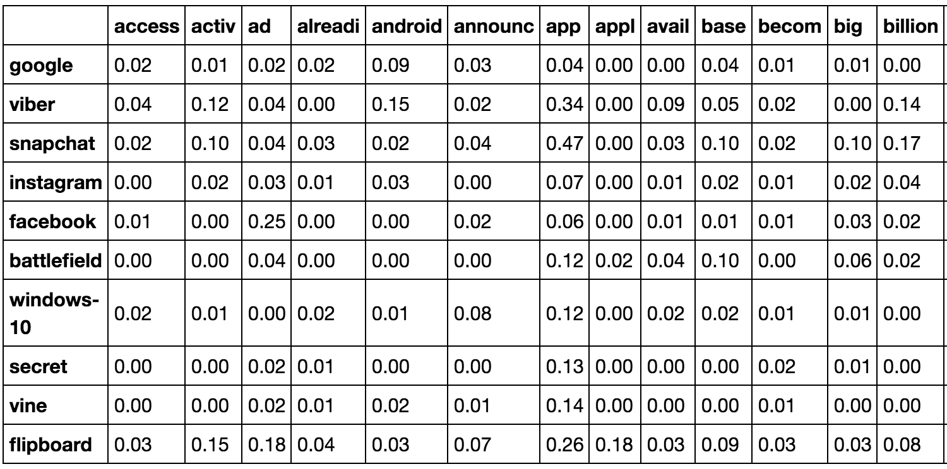
TF-IDF Matrix

Slide 17
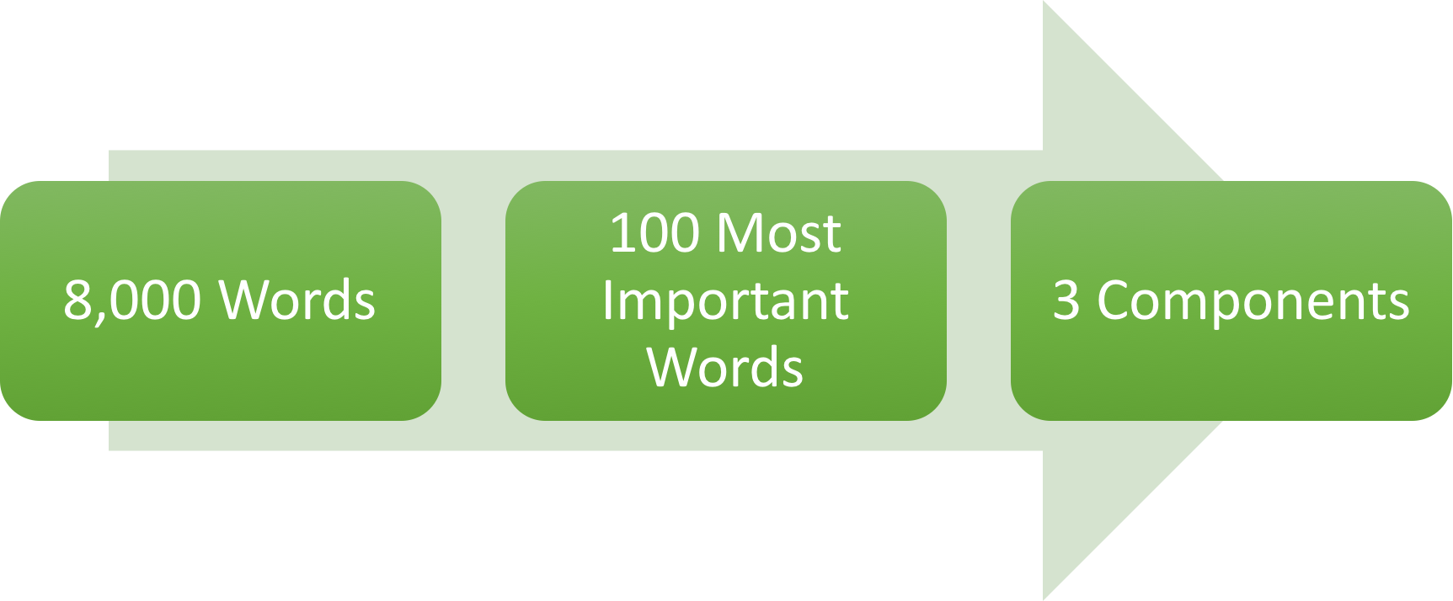
Dimensionality Reduction
Principle Components Analysis using SVD

Slide 18

Clustering

Slide 19
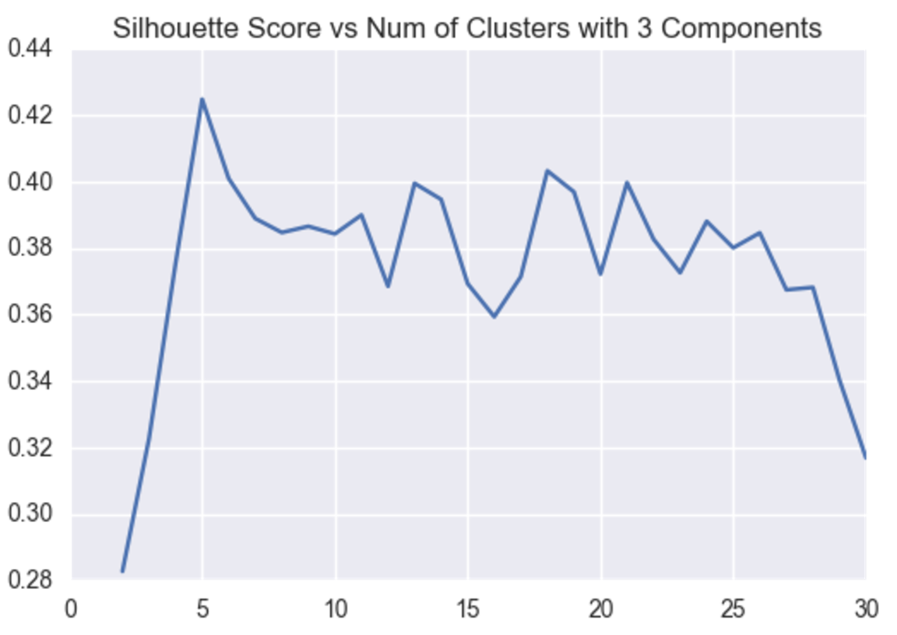

Slide 20
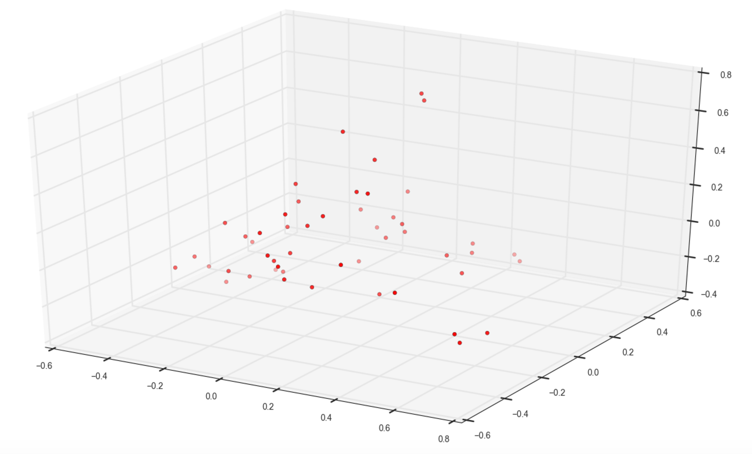

Slide 21
Topic
Recommended Topic

Slide 22
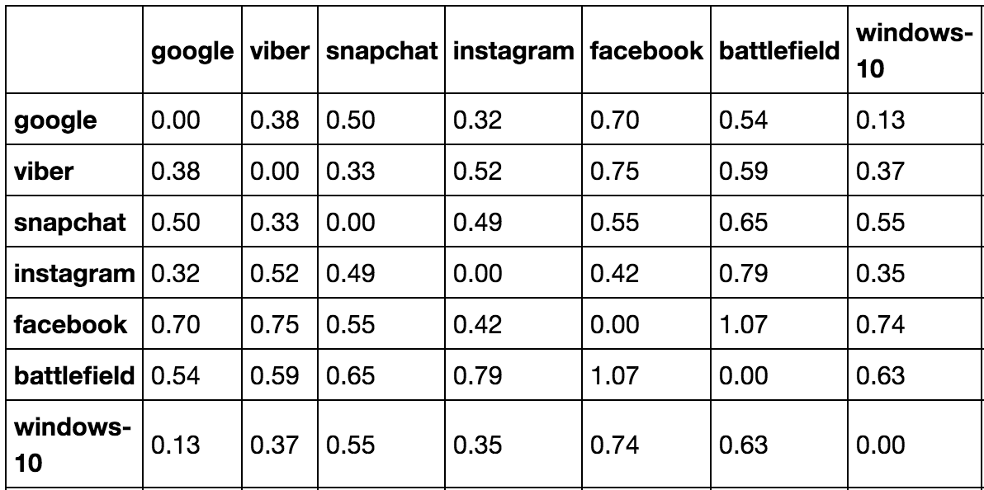
Euclidean Distance Matrix

Slide 23
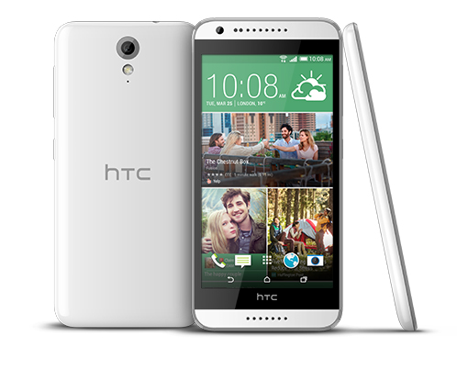
Example Recommendation
HTC
Blackberry: 0.06
Nokia: 0.07
Iphone: 0.15

Slide 24

Example Recommendation
Facebook
Facebook-Messenger: 0.02
Facebook-Ipo: 0.03
Facebook-Whatsapp: 0.24

Slide 25

Example Recommendation
Twitter
Jack-Dorsey: 0.03
Vine: 0.14
Twitter-Vine: 0.15

Slide 26
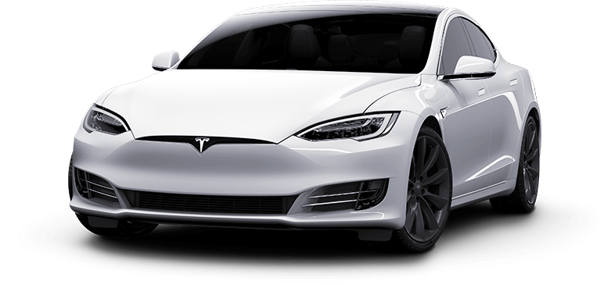
Example Recommendation
Tesla
Windows-10: 0.13
FlipBoard: 0.18
Raspberry-Pi: 0.20

Slide 27
Web App using Flask

Slide 28
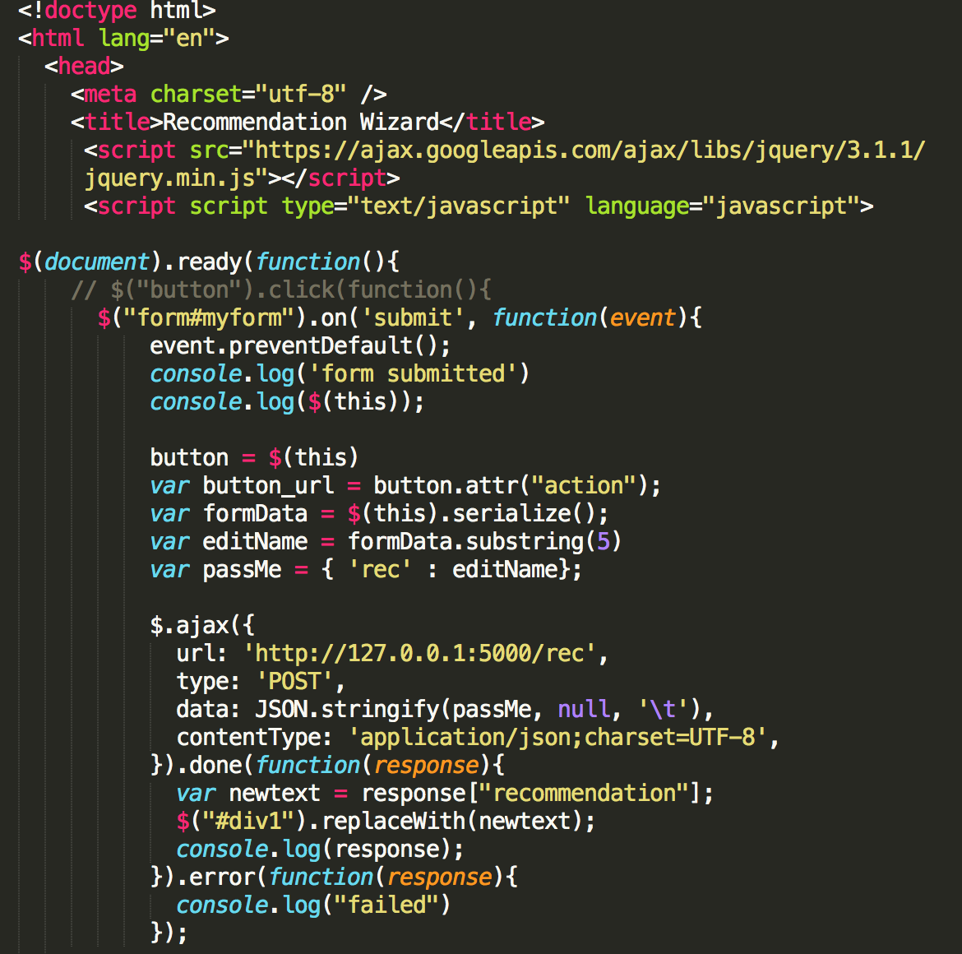

Slide 29
http://127.0.0.1:5000/

Slide 30
Sentiment Analysis

Slide 31
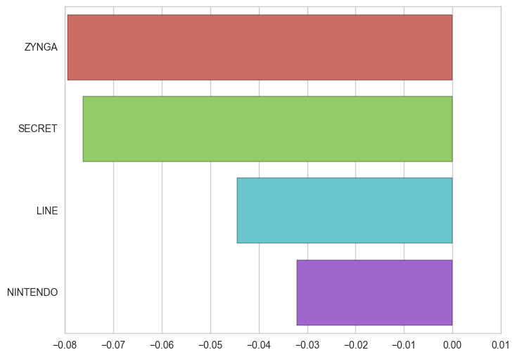

Slide 32
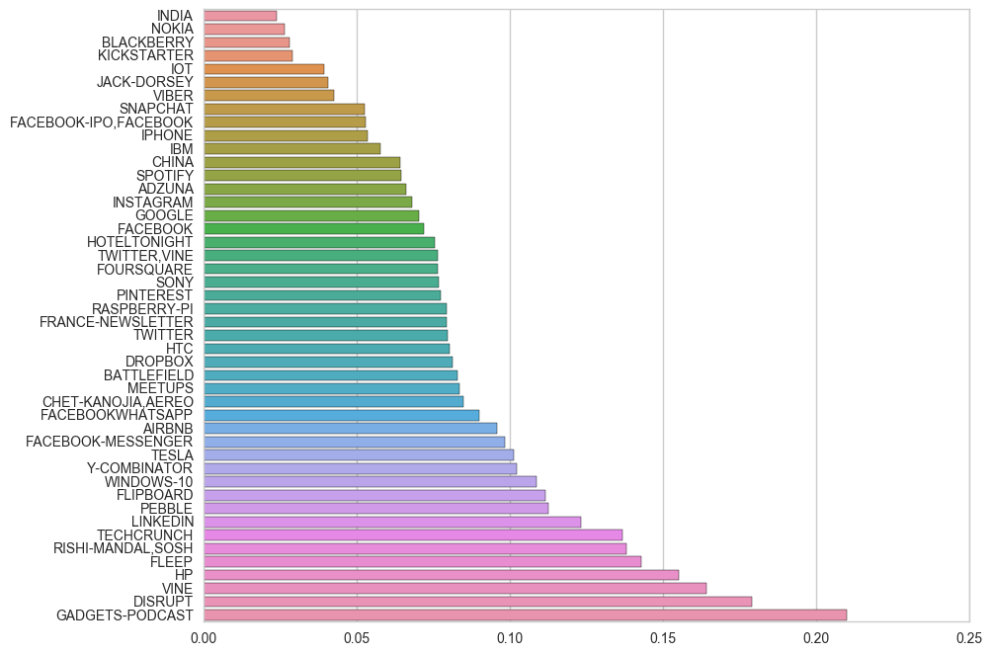

Slide 33
Future Works
Expand the number of topics to more than 50
Improve the Flask web app
Time series analysis on sentiments

